Slide 1
Do It Safe
Secure Software Engineering Case Study A.A. 2020/2021
Paolo Gasparro
Giovanni Forleo
Ardavan Shahoveisi
Karthikeyan Muppuri

Slide 2

SYSTEM: CIVIC SENSE
The system allows the citizen to notify failures, problems, malfunctions and, in general, relevant events for a subject that provides services or manages infrastructure of public interest (water, electricity, roads, urban safety, etc. ...).

Slide 3
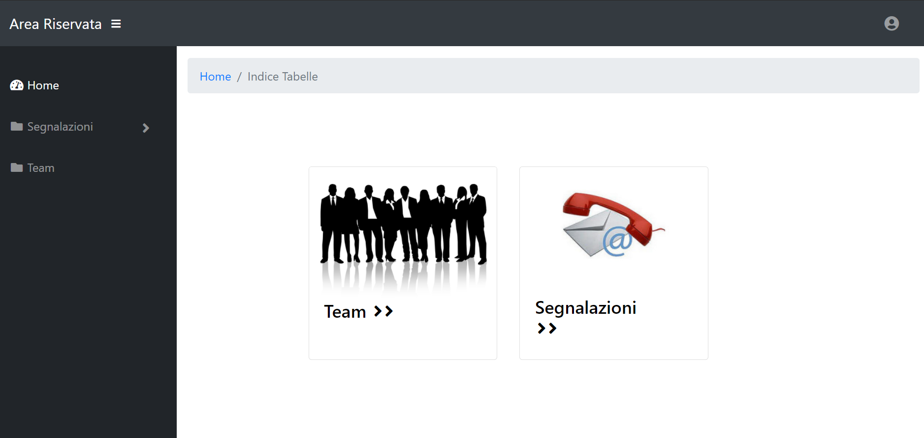
HOW THE SYSTEM WAS
The main interface of the system:

Slide 4
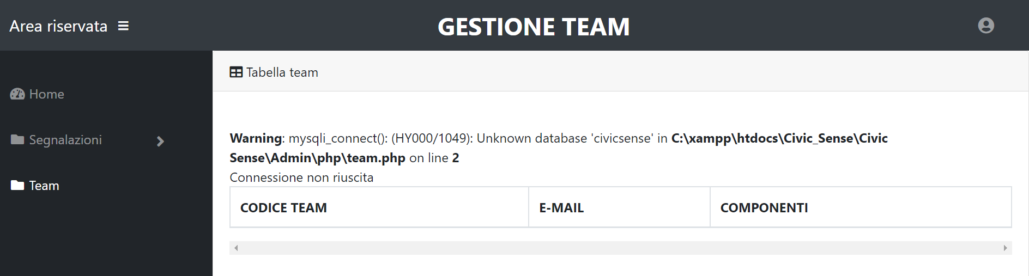
HOW THE SYSTEM WAS
The system was not able to show all functionality for which it was created. Browsing through the pages, clicking the ‘Team button’, it was immediately clear that a database with some data was missing, as shown below:

Slide 5
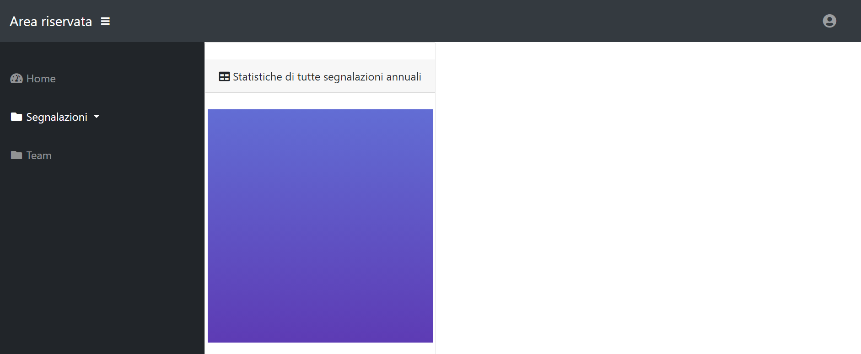
HOW THE SYSTEM WAS
Clicking on ‘Segnalazioni button’, the system did not seem to work properly.

Slide 6
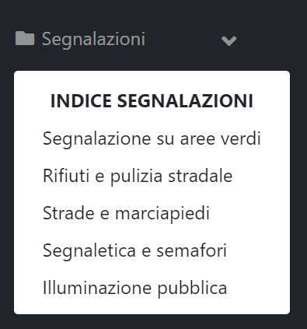
HOW THE SYSTEM WAS
Even clicking on 'Segnalazioni button' on the left part of the page, the dropdown menu shows the five sub-categories:

Slide 7
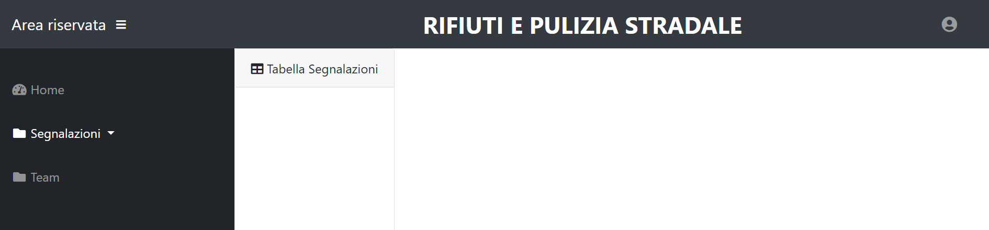
HOW THE SYSTEM WAS
However, clicking on each sub-category, it was evident that also in this case the table was missing:

Slide 8
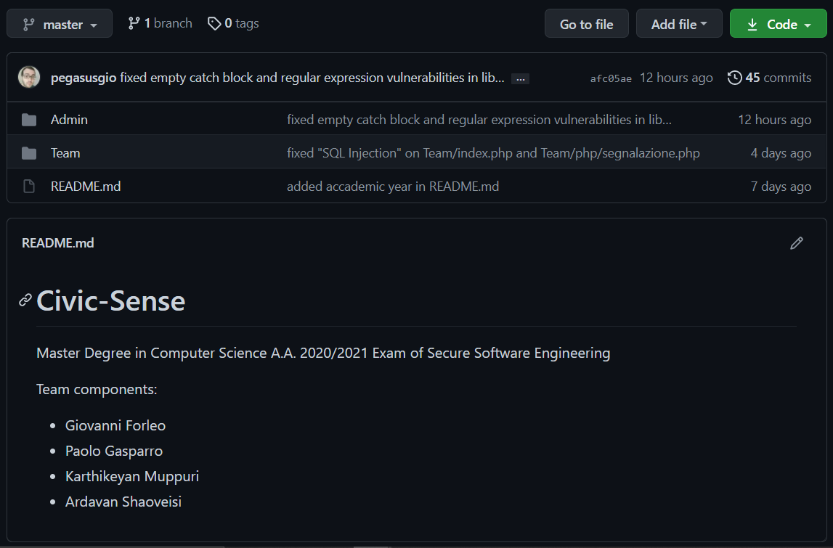
HOW THE SYSTEM IS
It was evident that the system had to be fixed in some ways to let
the team understand the full functionalities of it and act
consequently (even with vulnerability fixes).
To work on group and track all the modifications remotely, it has
been used the GitHub as versioning tool.

Slide 9

HOW THE SYSTEM IS
CIVIC SENSE
Live Demo

Slide 10

VULNERABILITIES ANALYSIS
Static code analysis has been performed using Fortify SCA scan tool.

Slide 11
STATIC CODE ANALYSIS: INITIAL STATE
Below there is the report containing all the 433 vulnerabilities
revealed from the first scan (on the original system) categorized by business risk (Critical, High, Medium, and Low).
Issues by Priority
240
113
4
76
CRITICAL
HIGH
MEDIUM
LOW

Slide 12
STATIC CODE ANALYSIS: INITIAL STATE
 | CRITICAL | HIGH | MEDIUM | LOW
A1 Injection | 39 | 6 | 2 | 6 | 53 | 433 | OWASP Top Ten 2017 Category
A2 Broken Authentication | 0 | 0 | 0 | 0 | 0
A3 Sensitive Data Exposure | 35 | 89 | 0 | 36 | 160
A4 XML External Entities (XXE) | 0 | 0 | 0 | 0 | 0
A5 Broken Access Control | 1 | 2 | 0 | 0 | 3
A6 Security Misconfiguration | 0 | 0 | 0 | 0 | 0
A7 Cross-Site Scripting (XSS) | 165 | 0 | 2 | 0 | 167
A8 Insecure Deserialization | 0 | 0 | 0 | 0 | 0
A9 Using Components with Known Vulnerabilities | 0 | 0 | 0 | 0 | 0
A10 Insufficient Logging and Monitoring | 0 | 0 | 0 | 0 | 0
None | 0 | 16 | 0 | 34 | 50

Slide 13
STATIC CODE ANALYSIS: FINAL STATE
Here, instead, the final scan after all the possible fixes, reporting
46 problems grouped in the following way:
Issues by Priority
6
7
2
31
CRITICAL
HIGH
MEDIUM
LOW

Slide 14
STATIC CODE ANALYSIS: FINAL STATE
 | CRITICAL | HIGH | MEDIUM | LOW
A1 Injection | 0 | 6 | 2 | 2 | 8 | 46 | OWASP Top Ten 2017 Category
A2 Broken Authentication | 0 | 0 | 0 | 0 | 0
A3 Sensitive Data Exposure | 6 | 0 | 0 | 0 | 0
A4 XML External Entities (XXE) | 0 | 0 | 0 | 0 | 0
A5 Broken Access Control | 0 | 0 | 0 | 0 | 0
A6 Security Misconfiguration | 0 | 0 | 0 | 0 | 0
A7 Cross-Site Scripting (XSS) | 0 | 0 | 0 | 0 | 0
A8 Insecure Deserialization | 0 | 0 | 0 | 0 | 0
A9 Using Components with Known Vulnerabilities | 0 | 0 | 0 | 0 | 0
A10 Insufficient Logging and Monitoring | 0 | 0 | 0 | 0 | 0
None | 0 | 7 | 0 | 29 | 36

Slide 15
CRITICAL VULNERABILITIES
SQL Injection | 39
Password Management: Hardcoded Password | 3
Privacy Violation | 32
Path Manipulation | 1
Cross Site Scripting | 165
 | 240

Slide 16
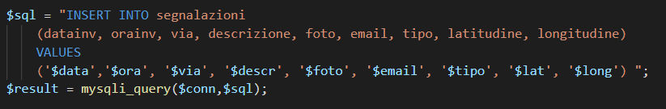
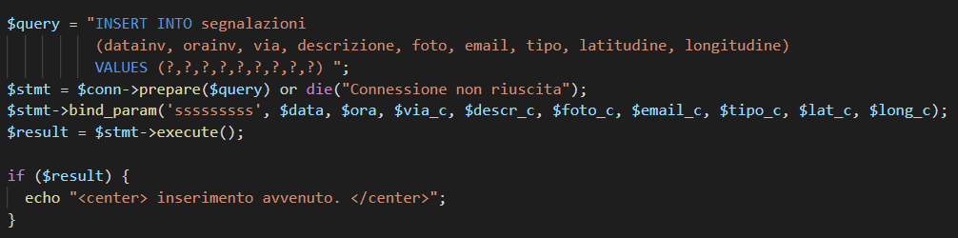
EXAMPLE OF CRITICAL VULNERABILITY
…AND ITS FIX

Slide 17
HIGH VULNERABILITIES
Log Forging | 6
Password Management: Empty Password | 83
Privacy Violation: Autocomplete | 4
Weak Encryption: Inadequate RSA Padding | 2
Access Control: Database | 2
Denial of Service: Regular Expression | 4
Insecure Randomness | 12
 | 113

Slide 18
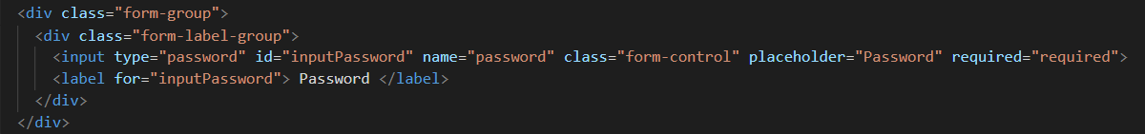
EXAMPLE OF HIGH VULNERABILITY
…AND ITS FIX

Slide 19
MEDIUM VULNERABILITIES
Often Misused: File Upload | 2
Cross-Site Scripting: Poor Validation | 2
 | 4

Slide 20
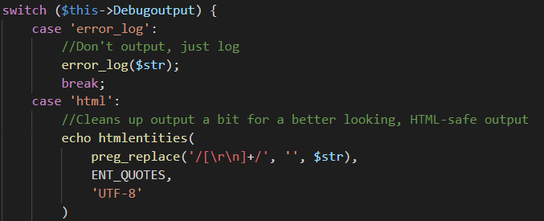
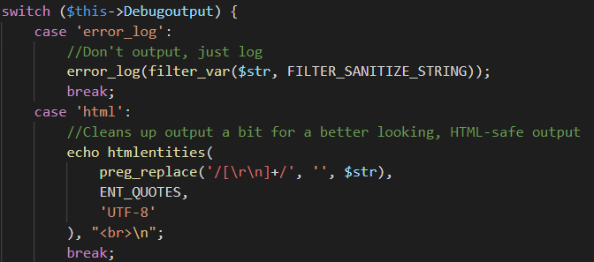
EXAMPLE OF MEDIUM VULNERABILITY
…AND ITS FIX

Slide 21
LOW VULNERABILITIES
Command Injection | 4
SQL Injection | 2
Password Management: Password in Comment | 20
Weak Cryptographic Hash | 16
Cross-Site Request Forgery | 22
Hardcoded Domain in HTML | 6
JavaScript Hijacking: Vulnerable Framework | 6
System Information Leak: External / Internal | 4
 | 76

Slide 22
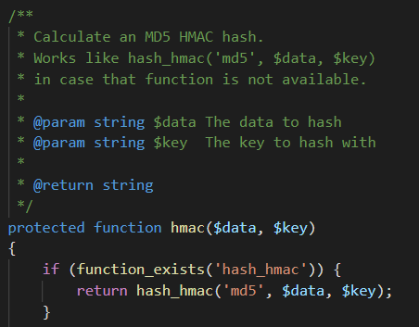
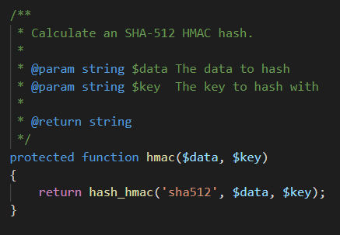
EXAMPLE OF LOW VULNERABILITY
…AND ITS FIX

Slide 23
UNRESOLVED VULNERABILITIES
CRITICAL
HIGH
MEDIUM
LOW
Privacy Violation (6)
Insecure Randomness (7)
Often Misused: File Upload (2)
Command Injection (2)
Cross-Site Request Forgery (22)
JavaScript Hijacking: Vulnerable Framework (3)
System Information Leak: Internal (2)
System Information Leak: External (2)
Total: 46

Slide 24
UNRESOLVED VULNERABILITIES
Insecure Randomness | False Positive
Often Misused: File Upload | False Positive
Command Injection | 3-rd party library upgrade
System Information Leak: Internal | 3-rd party library upgrade
System Information Leak: External | 3-rd party library upgrade
A possible fix for the missing unresolved vulnerabilities will be explained in the Privacy Analysis section

Slide 25
VULNERABILITES NOT IDENTIFIED BY FORTIFY
A3 Sensitive Data Exposure
The system has an image folder containing possible sensitive information. The data should be stored encrypted, and then decrypted before to be used. Moreover, the names of the files suggest the date in which that image has been taken
A5 Broken Access Control
In ‘Admin/login.php’ file there is an if statement that contains a wrong check condition: if a user inserts the correct mail OR the correct password (not both), can access into the system.
The file ‘Admin/inserisci.php’ contains hardcoded password of the database

Slide 26
VULNERABILITES NOT IDENTIFIED BY FORTIFY
During the login process, and without knowing any kind of credential (mail or password), it is possible for everybody to access to the private area (Admin) just removing ‘login.php’ from the URL.
In the main page of the system, if an attacker uses the inspect element mode, can see the path in the server which contains an error that shows the path of the file
When trying to logout after logging-in as Team, the system redirects to a non-existing page ‘login.php’ so it gives an error. This is due to the fact that in the file ‘Team/index.php’ there is a wrong href tag value which redirects to a non-existing file (login.php).

Slide 27
VULNERABILITES NOT IDENTIFIED BY FORTIFY
A9 Using components with Known Vulnerabilities
In the project there are some dwsync.xml files. If an attacker exploits these files, can retrieve important information. This vulnerability is called ‘Adobe Dreamweaver dwsync.xml Remote Information Disclosure’. As said before Adobe's Dreamweaver is known to produce 'dwsync.xml' files. These contain synchronization information that may include the list of files and directories synchronized. This can lead to information disclosure.
There are two file that cannot be reached browsing the entire system (‘Admin/inserisci.php’ e ‘Admin/php/loginn.php’). However, if an attacker uses some scanning tool can find these files and use them to retrieve some sensitive data.

Slide 28

OBSERVATIONS
Same observation that emerged from the analysis

Slide 29

PRIVACY ANALYSIS
This part involves the identification of Privacy Design Strategies for system re-engineering and the use of Privacy Design Patterns to explain the unresolved vulnerabilities

Slide 30


CONTENT
Privacy Assessment
Unresolved vulnerabilities
Privacy pattern applied
Privacy Report
Design Strategies
Privacy pattern to explain how them can be solved

Slide 31
Privacy Assessment
In the Privacy Assessment, the vulnerabilities identified during the static code analysis in the section 2 are provided as input to the Privacy Knowledge Base to identify:
➢ The principles of Privacy by Design violated by vulnerabilities;
➢ The Privacy Design Strategies to be implemented in the system to respect the principles of Privacy by Design;
➢ The privacy patterns that substantiate the Privacy Design Strategies.
The results of this analysis are reported in the Privacy Report.

Slide 32
Privacy Pattern
The list of the Privacy Patterns applied is composed by:
Personal Data Store (SEPARATE – CONTROL)
Encryption with user-managed keys (HIDE – CONTROL)
Anonymous reputation-based Blacklist (HIDE)
Metadata Manager (MINIMIZE)
Location Granularity (ABSTRACT)
Onion Routing (HIDE)
Unusual Activities (INFORM)
Data Breach Notification Pattern (INFORM)
Sticky Policies (ENFORCE)
Federated Privacy Assessment (DEMONSTRATE)

Slide 33
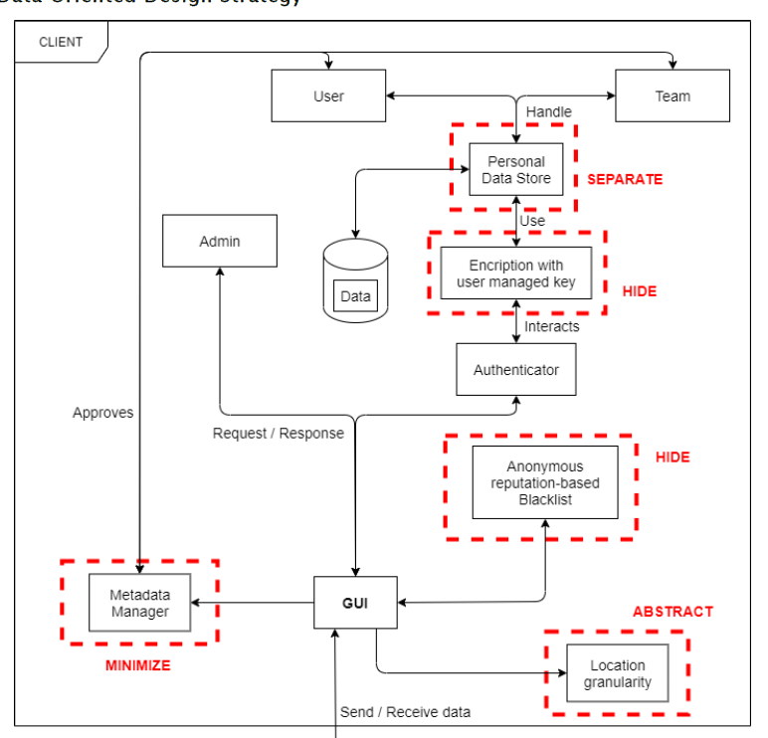
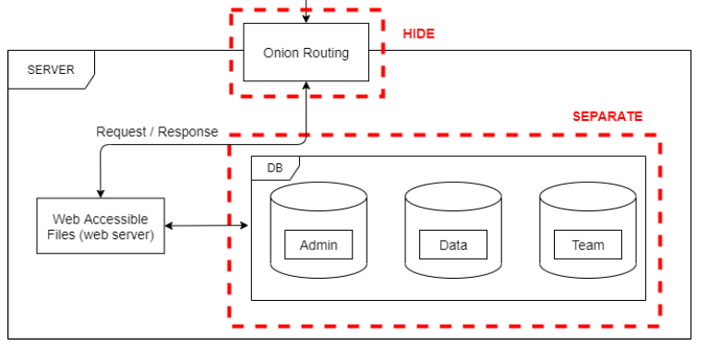
Data Oriented Design Strategy
Client side
Server side

Slide 34
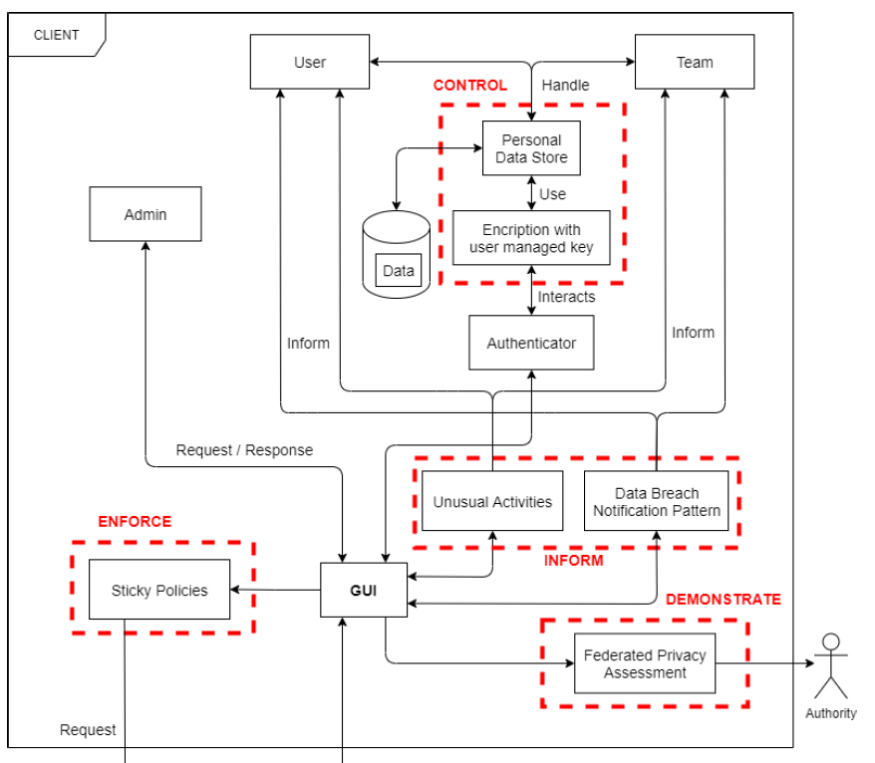
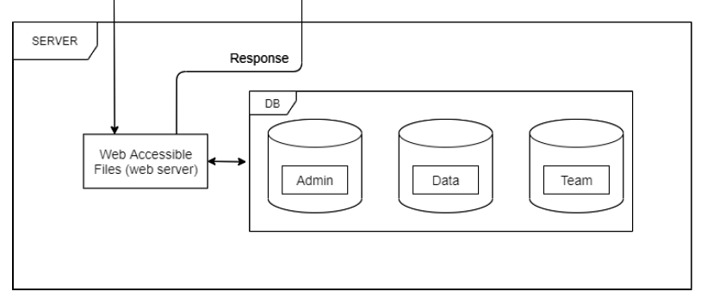
Process Oriented Design Strategy
Client side
Server side

Slide 35
Explaining unresolved vulnerabilities with Privacy Patterns
VULNERABILITY | DESCRIPTION | PATTERN
Privacy Violation | The solution is to let the user to generate and manage a strong encryption key to keep his personal information private, avoiding the transferring through untrusted 3rdparty services. | Encryption with user-managed keys
JavaScript Hijacking: Vulnerable Framework | The pattern chosen for this vulnerability consists in encrypt, aggregate and decrypt at different places. Indeed, a service provider gets continuous measurements of a service attribute linked to a set of individual service users. | Aggregation Gateway
Cross-Site Request Forgery | The privacy pattern identified and more compliant to this category is consists in stripping potentially sensitive metadata that is not directly visible to the end user. | Strip Invisible Metadata

Slide 36

Thanks for the attention
And remember…
whatever you have to do, Do It Safe

